Slide 1
HOSTELविभाग

Slide 2
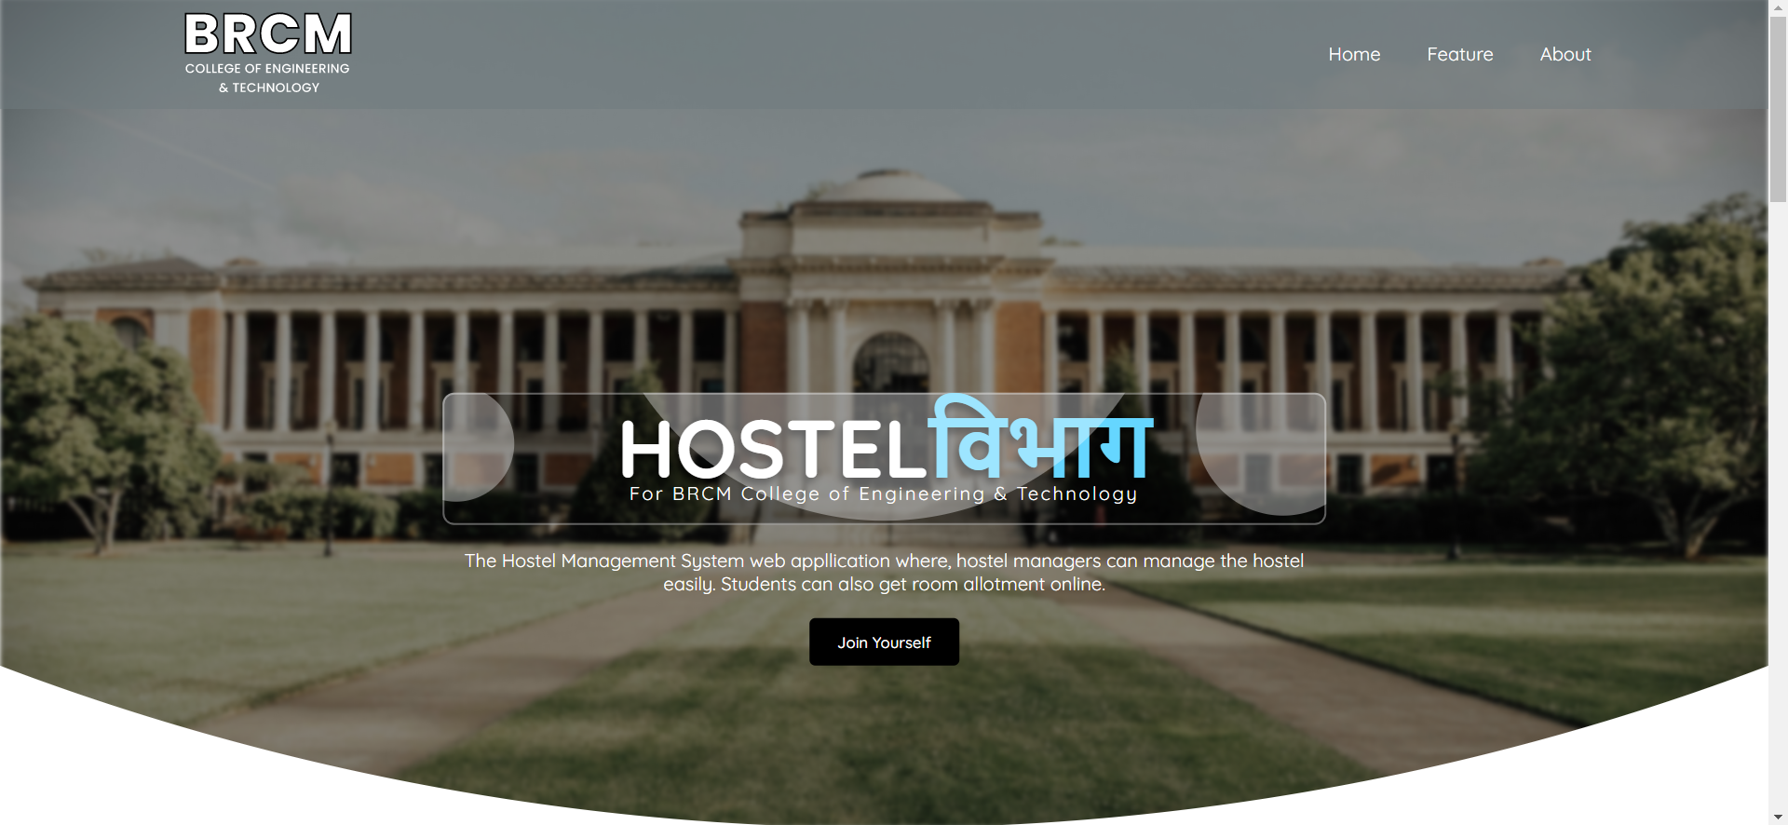
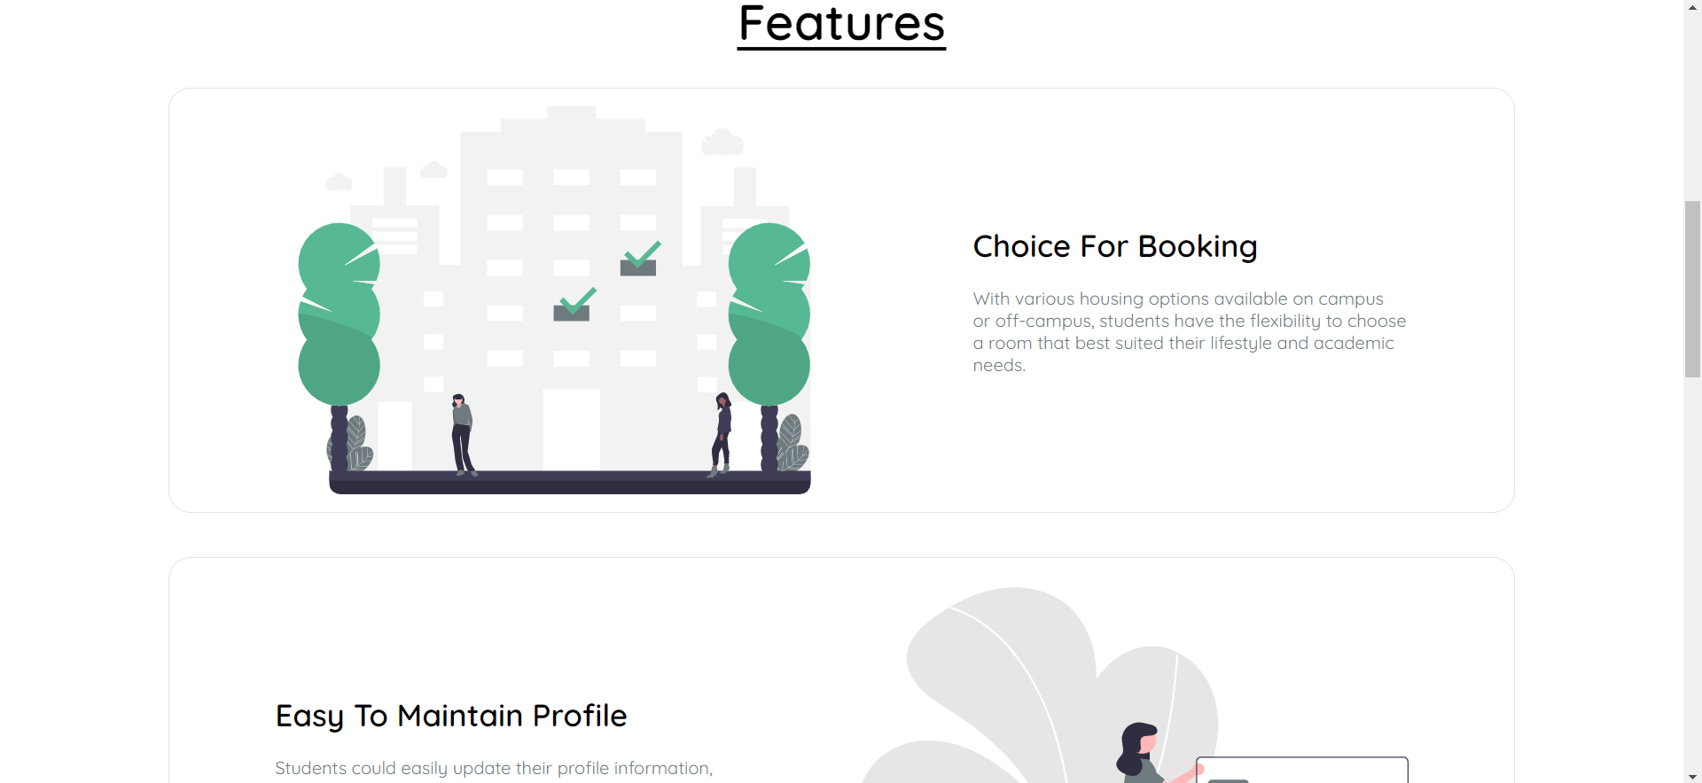
Landing Page
The Landing Page contain the whole information about the website HOSTELविभाग like features such as Room Booking facility, Flexible Searching facility and many more. There is a “Join Yourself” button that is for the confirmation about the visitors about the occupation his/her (e.g., Student, Warden, Supervisor.)
The navbar contains two main links that is About and Feature.
There is one more section where we try to put the thoughts of the Principle and Warden about the Hostel.
And at last the footer part that contains all the necessary links that will help the student to connect easily with the college socially.

Slide 3
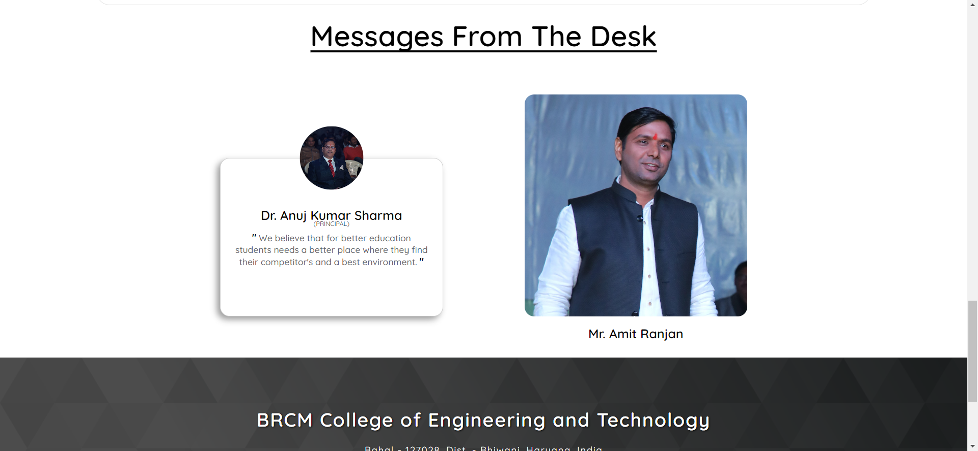
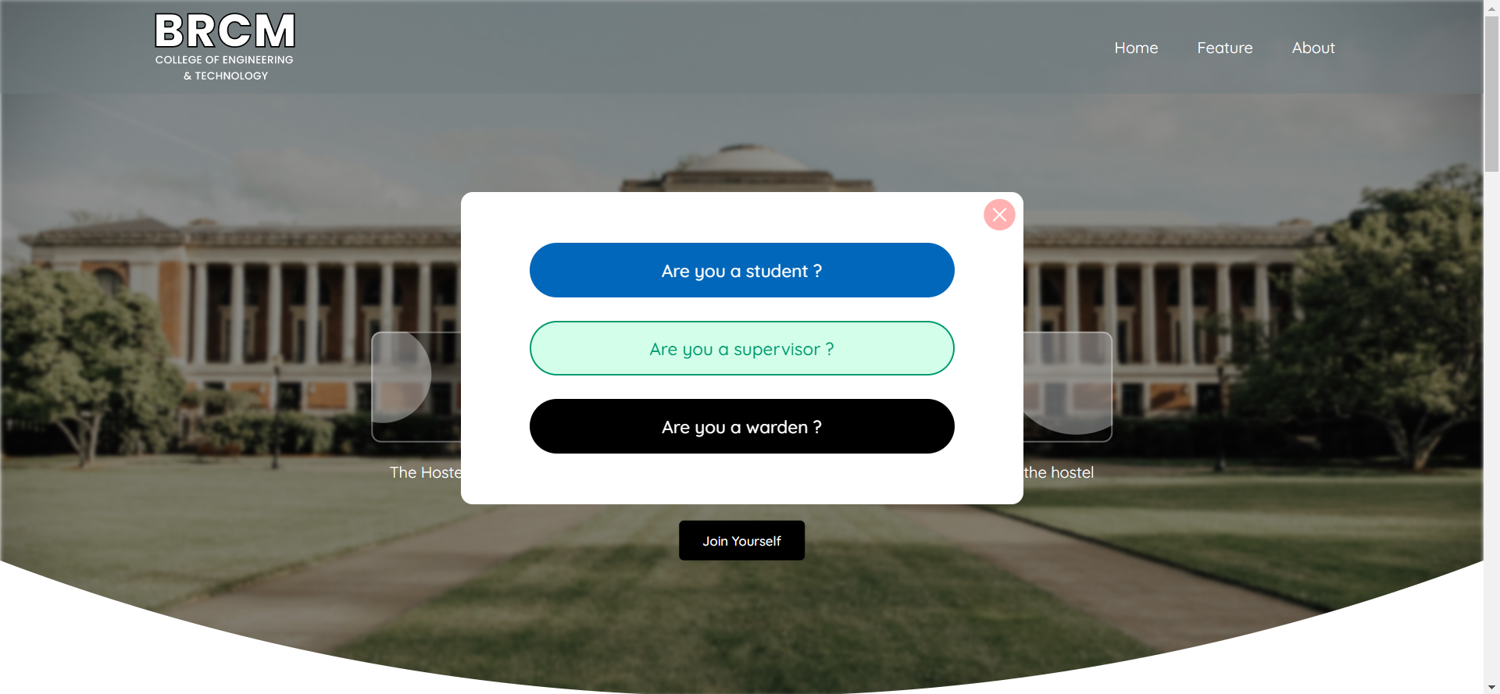

Slide 4
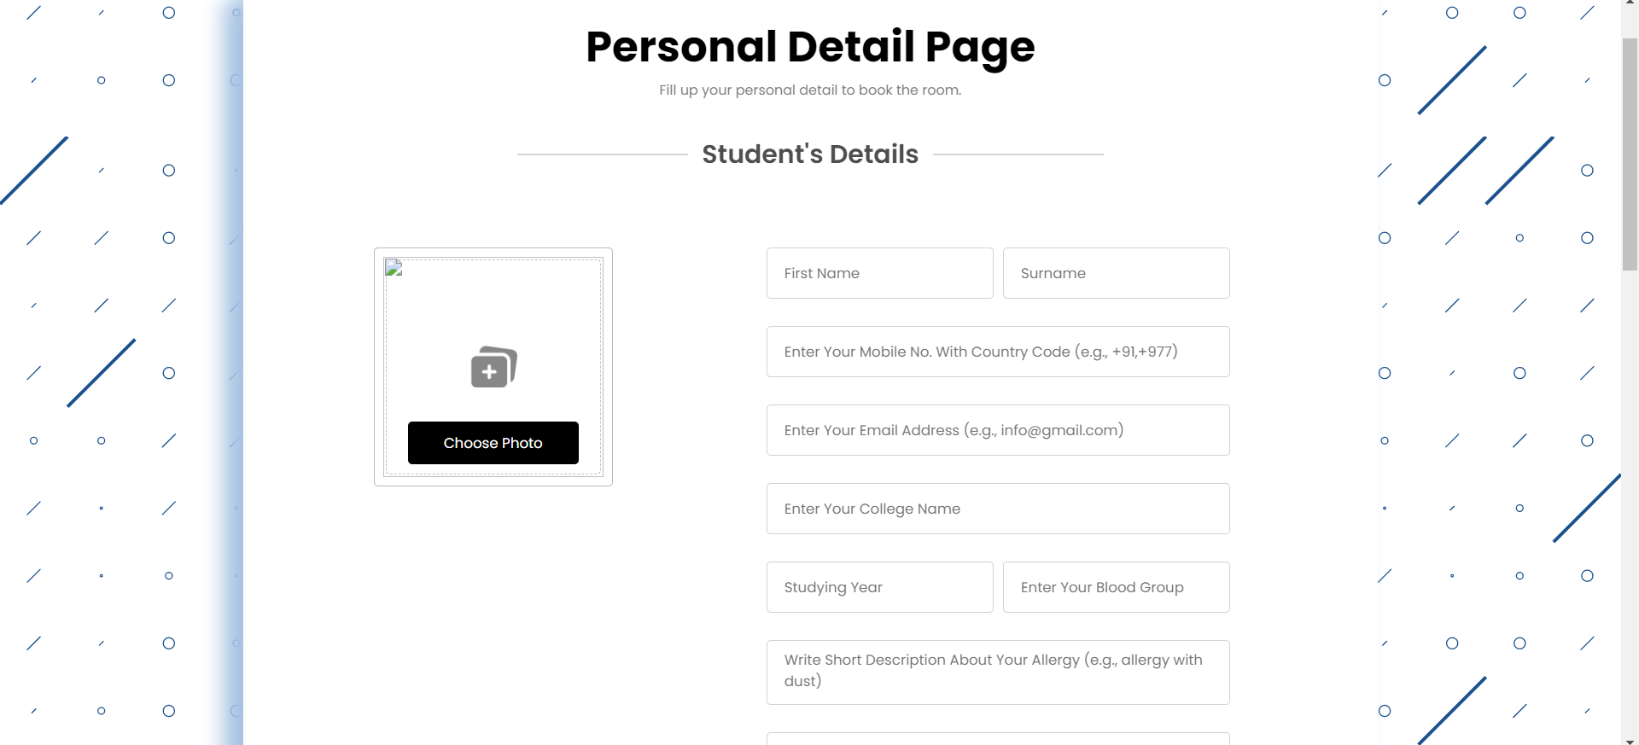
Personal Detail Page
When anyone make a click on the join button, the pop up will come that ask if the visitor is student, supervisor or warden. Let if the visitor is a student then he can click on the button of “Are you a student ? ” and they redirected to the another page for filling the personal details.
In this page, the student have to fill all the personal details like name, phone, email, parents detail, visitors detail and also the photos.

Slide 5
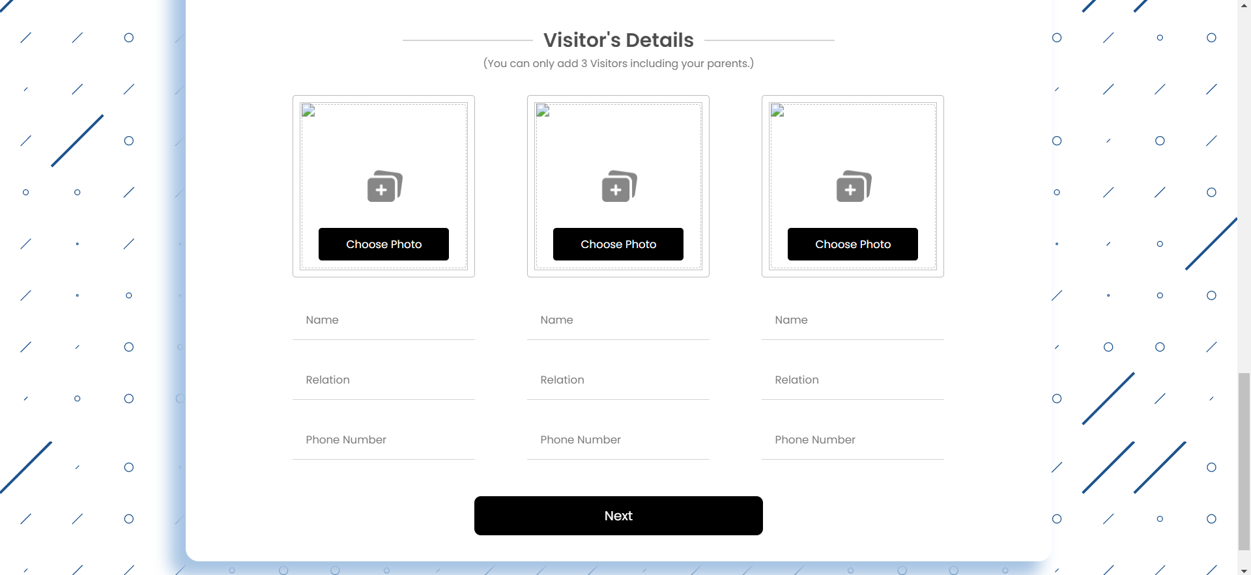
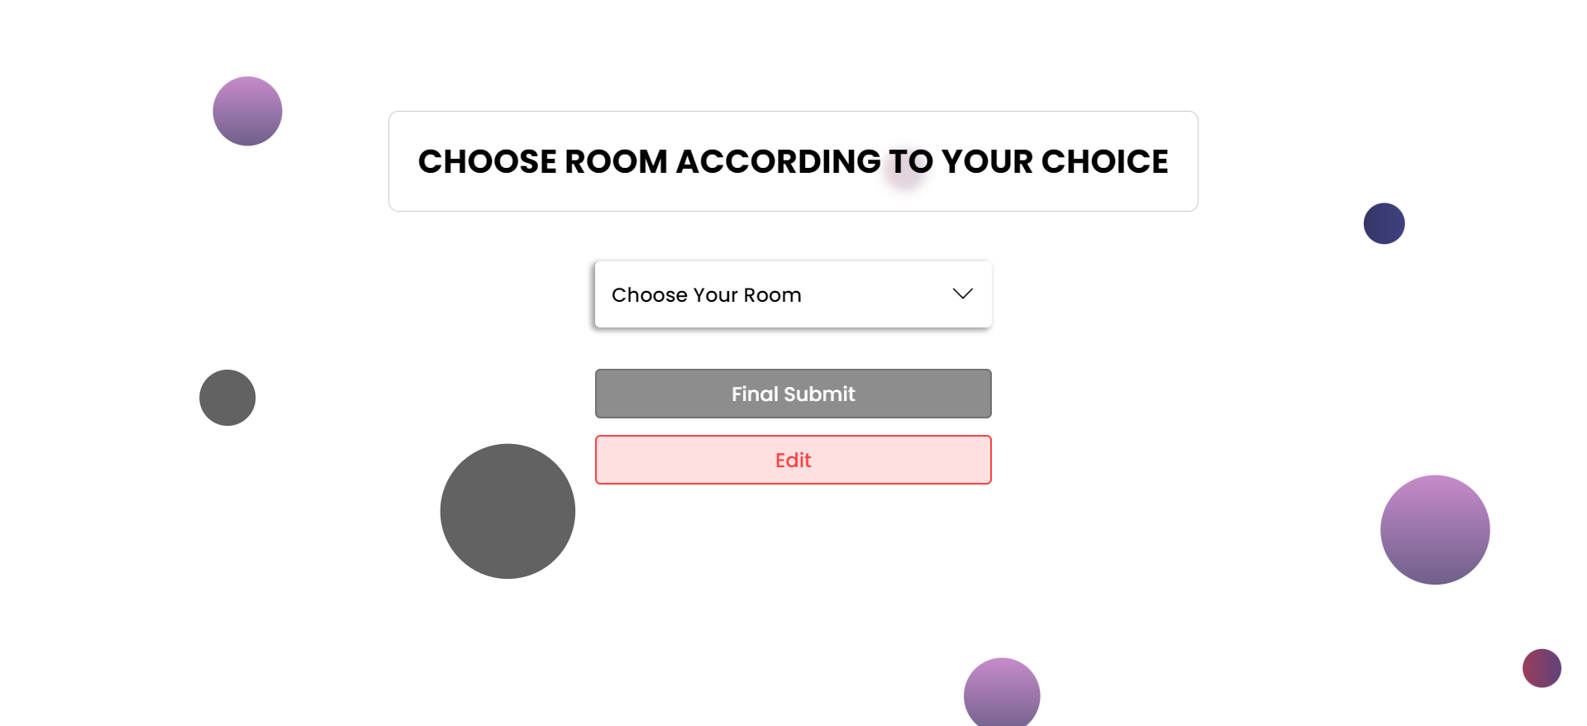
After filling the all input fields the student can click to the next button where he/she redirected to the “Room Booking” page.
The first interaction to this next page will reveals nothing to the student until they click on the “Choose Your Room” button.

Slide 6
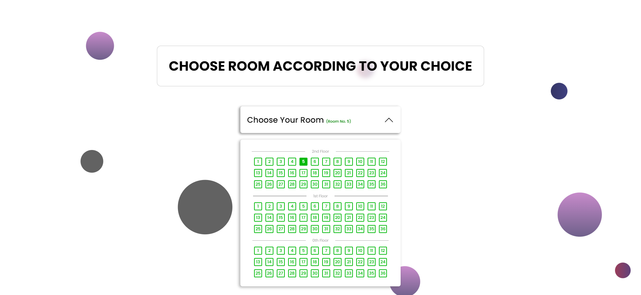
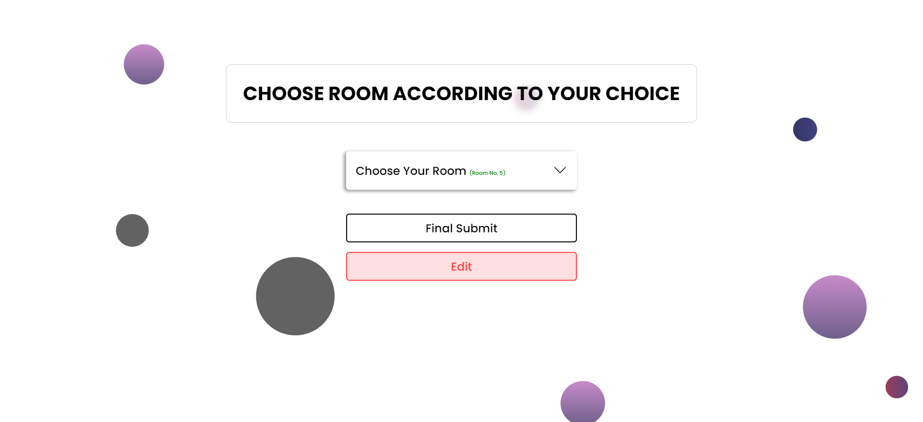
The Room Booking Page
The student can select the room by clicking on the “Choose Your Room” button. There we try to make a clear UI that will help students to book the rooms according to floors.
After choosing the room student can be able to submit the form or can also edit the value of previous page before submitting the page.

Slide 7
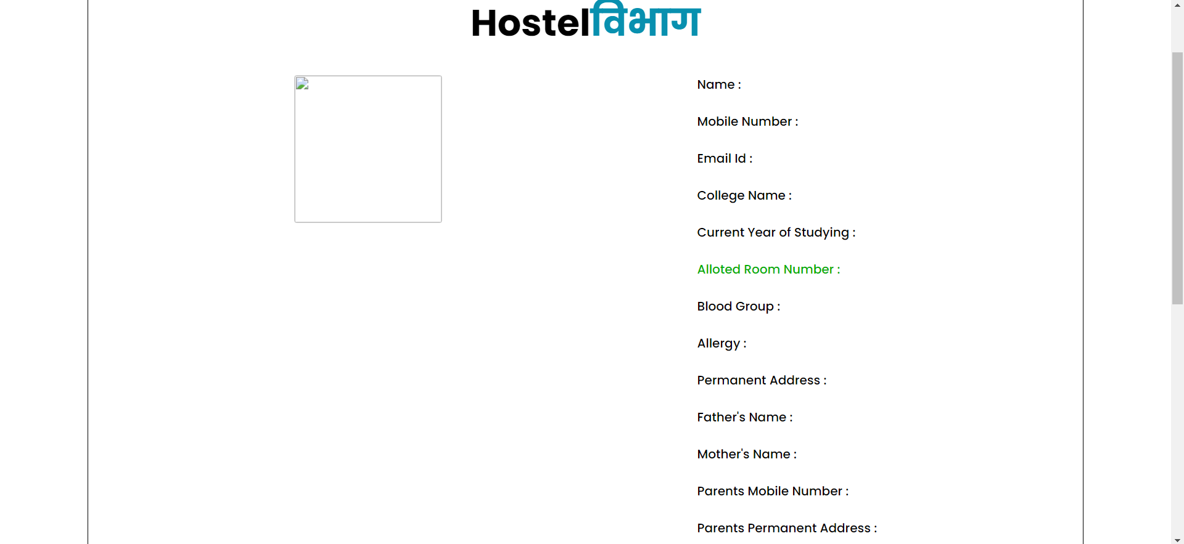
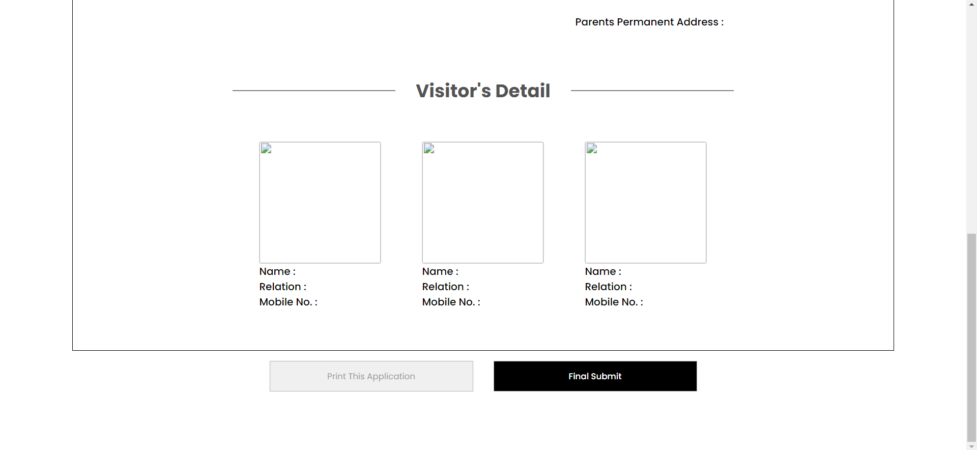
FINAL APPLICATION FORM
The final application form will contain all the information that student previously filled.

Slide 8
THANKYOU

